Slide 1
Marketing Campaign Analysis
Customer Conversion & Sales Insights

Slide 2
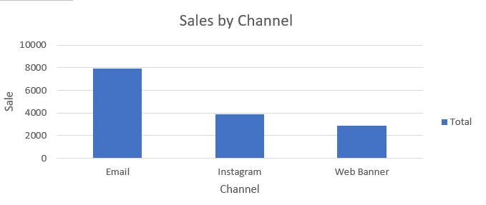
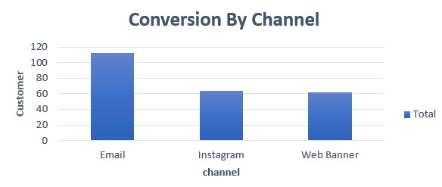
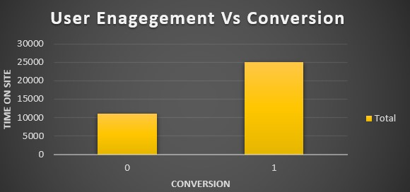
Overall Channel Performance
Sales Performance By Channel
Channel Wise Conversion
Converted Vs Non- Converted Customer
Recommendation :
Increase Investment in channels generating higher sales revenue.
Recommendation :
Allocate more budget to channels with higher Customer conversion.
Recommendation :
Optimize website content to keep users engaged longer

